Slide 1
OliOil: Transforming Oil Spill Response
A Comparative Analysis of Traditional Methods vs. OliOil Robotic Solutions

Slide 2
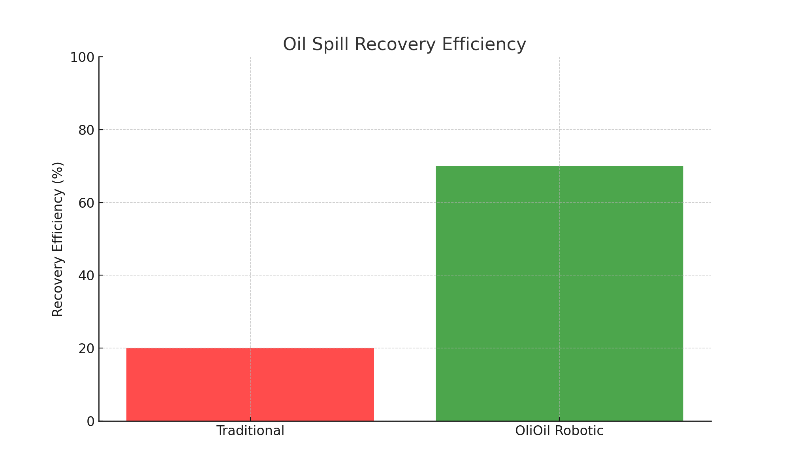
Oil Spill Recovery Efficiency

Slide 3
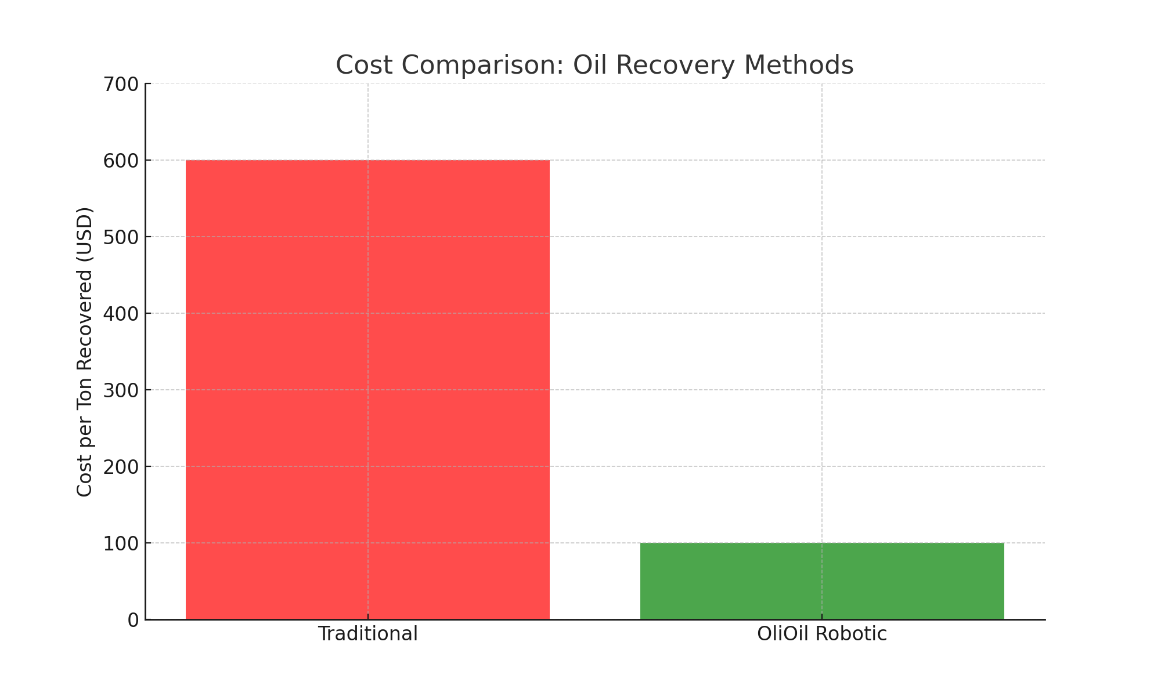
Cost Comparison: Cost per Ton Recovered

Slide 4
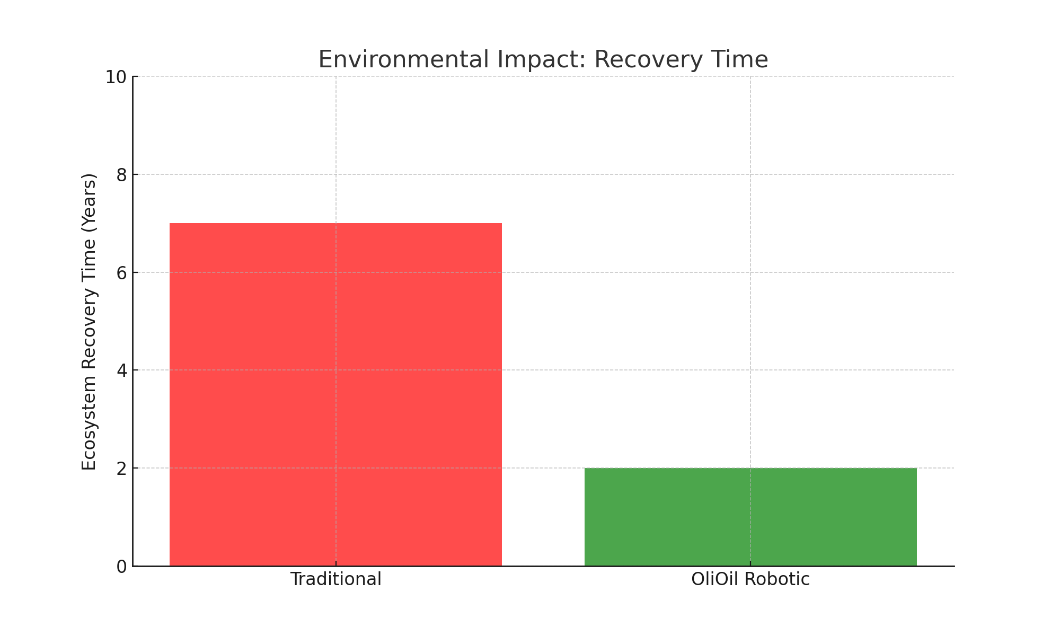
Environmental Impact: Ecosystem Recovery Time

Slide 5
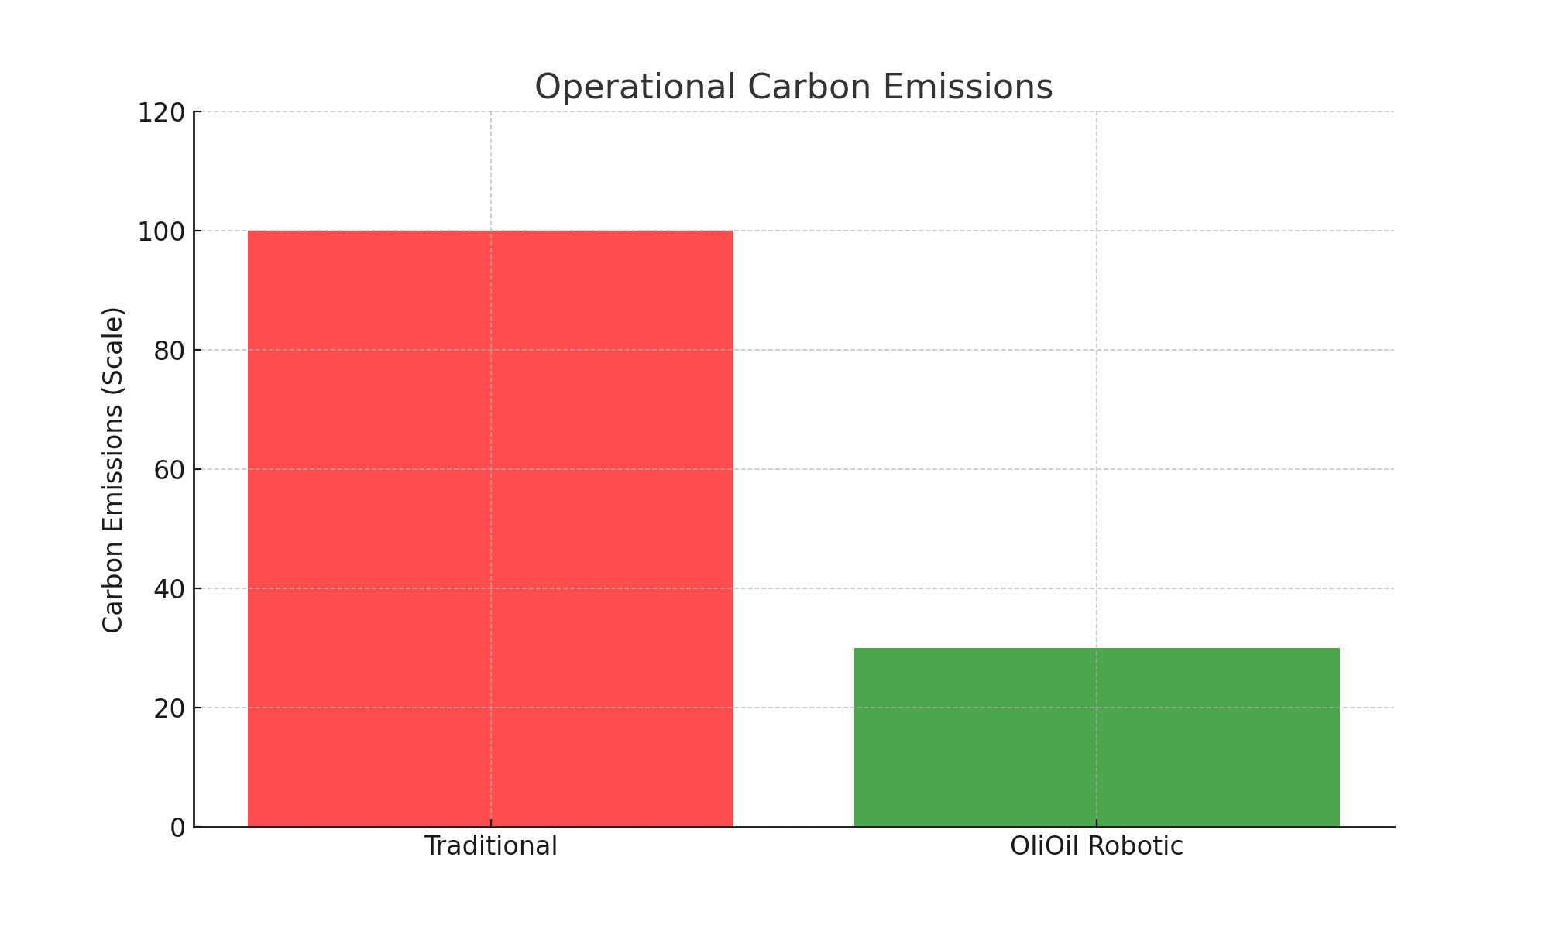
Operational Carbon Emissions

